Slide 1
Presented by:
Nehal Sugandh
PRN Number: 25070521251(E1)
Symbiosis Institute Of Technology, Nagpur
THE 0/1
KNAPSACK
PROBLEM
Dynamic Programming for Optimal Decision-Making
Generated using Gamma AI

Slide 2

THE DECISION
LIMITED SPACE,
MAXIMUM VALUE
You have a bag that can carry only 6 kg. Which items should you choose to maximize the total value?
Laptop — 3 kg, value 4
Camera — 2 kg, value 3
Headphones — 1 kg, value 2
Textbook — 4 kg, value 5
Power bank — 2 kg, value 3
6 KG
capacity

Slide 3


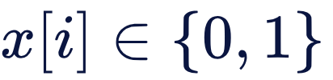
THE MODEL
EVERY ITEM IS A YES-OR-NO DECISION
0
1
Reject the item.
Select the item.
Each item must either be selected or rejected. Items cannot be divided.
Total weight must not exceed capacity. The goal is to maximize total value.
, where
0/1 Knapsack: indivisible yes/no choices · Fractional Knapsack: divisible portions

Slide 4



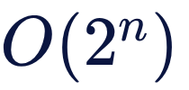
THE COST OF BRUTE FORCE
WHY NOT TRY EVERY COMBINATION?
Every item has two possible choices: include or exclude. With items, there are possible subsets.
1 CHOICE
2 CHOICES
Time complexity: , ignoring polynomial overhead.
4 CHOICES
8 CHOICES
Brute force can find the optimum, but becomes expensive as grows.
Can we solve the problem more intelligently?

Slide 5
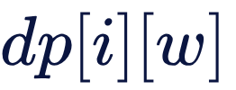


THE IDEA
DYNAMIC PROGRAMMING REMEMBERS THE USEFUL WORK
Overlapping subproblems: the same smaller capacities recur.
Optimal substructure: an optimal solution is built from optimal smaller solutions.
Reuse: store results instead of recomputing them.
i \ w | 0 | 1 | 2 | 3 | 4
0 | 0 | 0 | 0 | 0 | 0
1 | 0 | 0 | 0 | 4 | 4
2 | 0 | 0 | 3 | 4 | 4
3 | 0 | 2 | 3 | 5 | 6
4 | 0 | 2 | 3 | 5 | 6
Define as the maximum value obtainable using the first items with capacity .
A stored answer turns repeated work into a lookup.

Slide 6
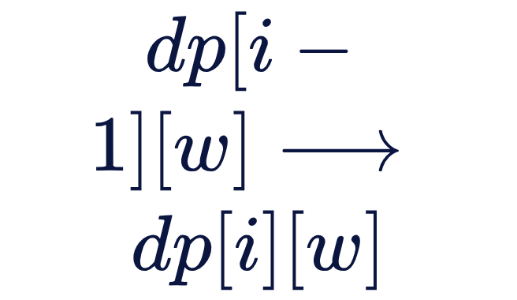
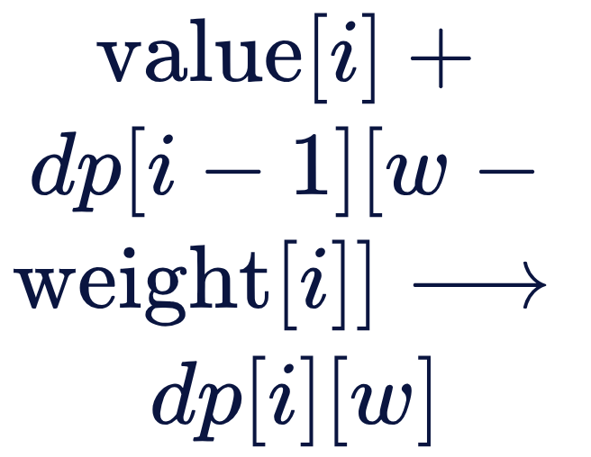
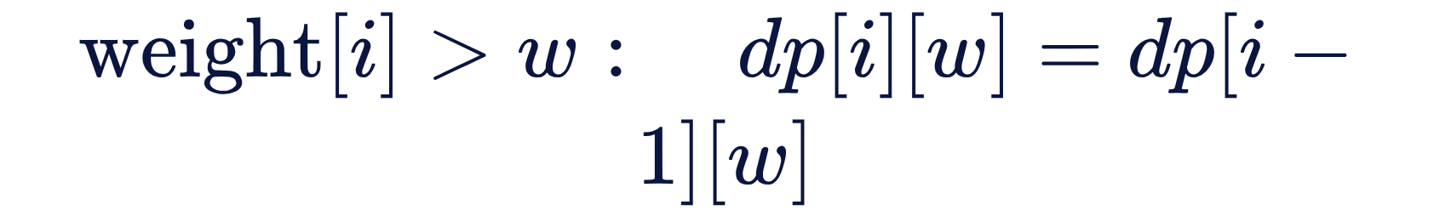
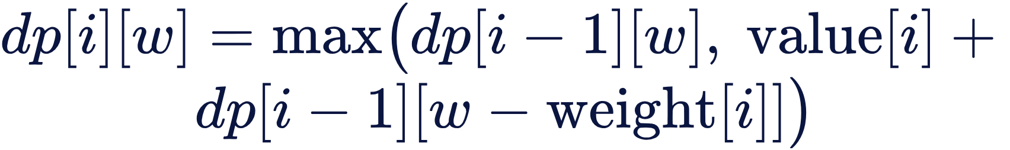
THE RECURRENCE
THE RECURRENCE CHOOSES THE BETTER PATH
Base cases
Otherwise, compare the two paths
Exclude
Include
No items or zero capacity gives zero value.
When it does not fit
Carry forward the best value without the current item.
Add its value to the best remaining capacity.
Carry forward the previous best.

Slide 7
FILLING THE TABLE, ONE DECISION AT A TIME
Rows are cumulative item sets; capacities 0 through 6.
Items used | 0 | 1 | 2 | 3 | 4 | 5 | 6
None | 0 | 0 | 0 | 0 | 0 | 0 | 0
Laptop | 0 | 0 | 0 | 4 | 4 | 4 | 4
Laptop + Camera | 0 | 0 | 3 | 4 | 4 | 7 | 7
+ Headphones | 0 | 2 | 3 | 5 | 6 | 7 | 9
+ Textbook | 0 | 2 | 3 | 5 | 6 | 7 | 9
+ Power bank | 0 | 2 | 3 | 5 | 6 | 8 | 9
dp[1][3] = 4
Include Laptop for 4; exclude for 0.
dp[3][6] = 9
Include laptop, camera, headphones; exclude for 7.

Slide 8
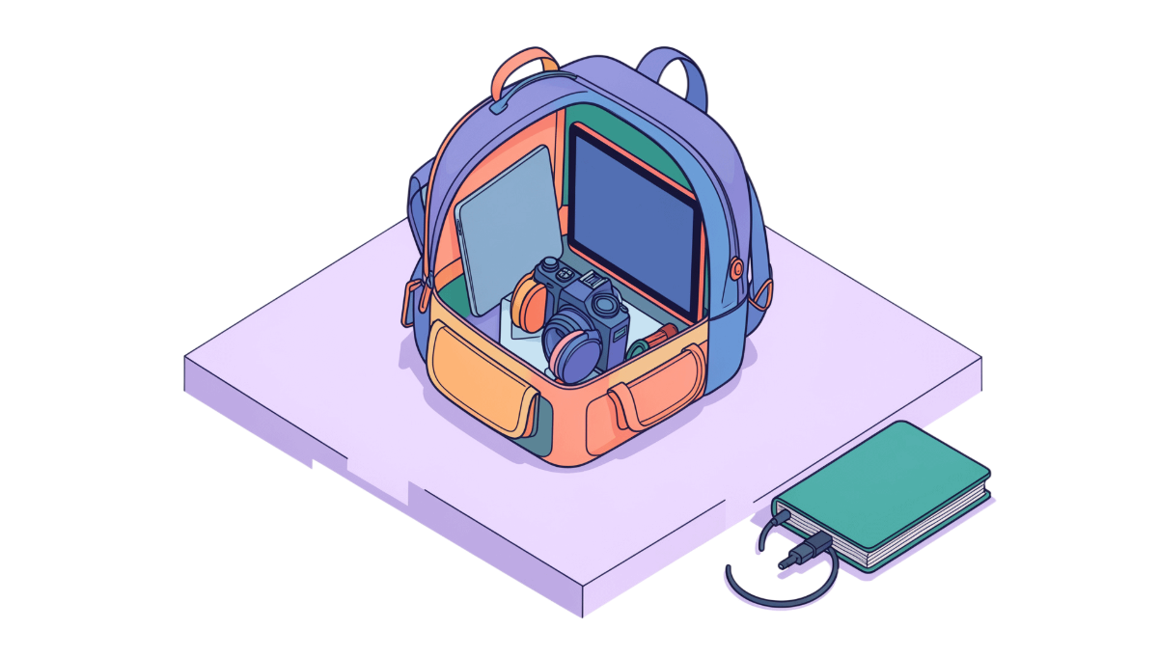

THE ANSWER
THE OPTIMAL DECISION IS WORTH 9
Laptop — 3 kg, value 4 · Camera — 2 kg, value 3 · Headphones — 1 kg, value 2
Total weight: 6 kg
Maximum total value: 9
Backtracking from : compare rows, identify where the value changes, and reconstruct the selected items.
Unselected: Textbook and Power bank

Slide 9
FROM A TABLE TO BETTER DECISIONS
COMPLEXITY
Real-world applications may require additional constraints.
Time: O(nW)
Space: O(nW) for the full DP table
Pseudo-polynomial: complexity depends on numeric capacity W
Takeaway: Dynamic programming helps us find the best combination by systematically reusing solutions to smaller problems.
REFERENCES
APPLICATIONS
Introduction to Algorithms by Cormen, Leiserson, Rivest, and Stein.
MIT OpenCourseWare materials on algorithms and dynamic programming.
Selecting projects under a limited budget
Cargo loading
Resource allocation in computing systems
Choosing features under a resource constraint
Generated using Gamma AI

Slide 10
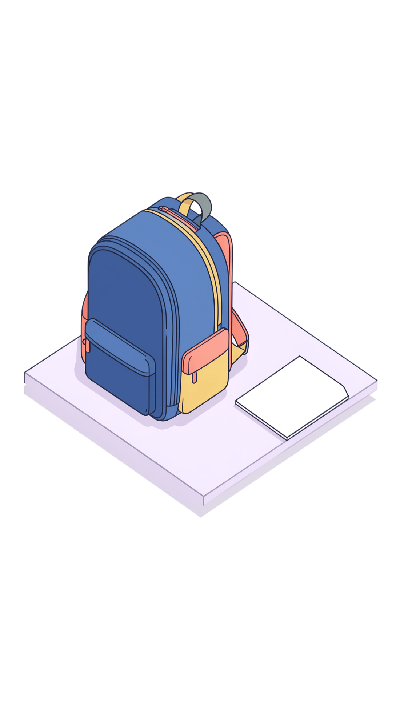
THANK YOU
Made With GAMMA

